Slide 1
Data Engineering 2: Big Data Architectures YouTube Data Pipeline
Dharshan Dhanashekar
Harshita Jamadade
Navneeth Krishna Aravind

Slide 2

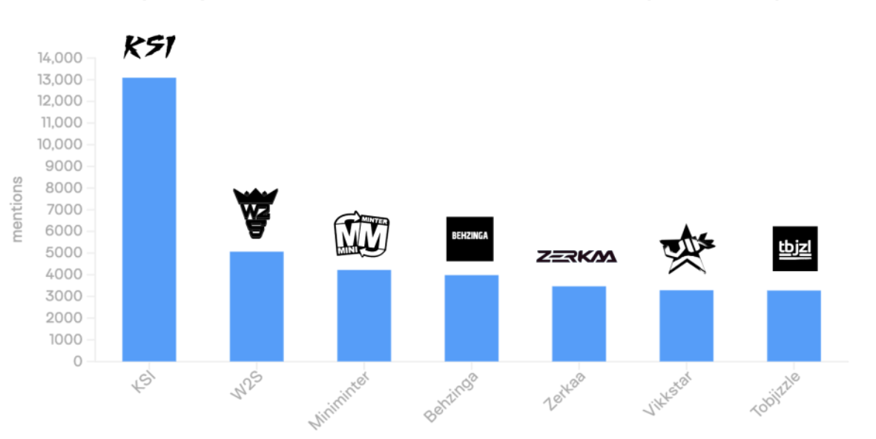
Introduction : Sidemen
Who are they ?
The Sidemen are a group of seven friends from the UK who create fun YouTube videos about games, challenges, and reactions, and have become super popular worldwide.
source : https://www.pulsarplatform.com/

Slide 3




What Do they Have on Market?
Food Ventures
Sidemen Clothing
Alcohol
Prime Energy Drink

Slide 4
Introduction to the Data Source
Data Source: YouTube Data API v3
Purpose: Analyze performance of Sidemen's YouTube channels
Channel Statistics
subscriber count, total views, video count, and description.
Endpoint youtube/v3/channels
Uploads Playlist
video IDs from the upload's playlist.
Endpoint youtube/v3/playlistItems
Video Details
views, likes, comments, tags, and upload dates.
Endpoint
youtube/v3/videos
Data Storage : Google Cloud Storage (GCS)
Format : JSON

Slide 5







Architechture
Cloud Scheduler
Dashboard & Analysis
Fetch Data Cloud Functions
Batch
YouTube API
YouTube Data Cloud Storage
Pipeline Trigger Cloud Functions
Data Processing Cloud Functions
Storage Big Query

Slide 6
Data Processing
Read Raw Data
Data is ingested from JSON files stored in Google Cloud Storage.
Parse and Extract Records
Transforms the JSON array into individual records for further processing.
Transform Data
Custom transformations
Calculate metrics (engagement rate, average views).
Format timestamps and video durations.
Identify viral videos
Load to BigQuery:
Data is written to BigQuery tables using schemas for:
Video Stats
Channel Stats

Slide 7
Challenges
Data Fetching and API Usage
Encountered "Too Many Requests" errors when fetching large-scale global data from the YouTube API.
Solution: Implemented batching, added delays between requests, and optimized API usage to reduce requests.
Runtime and Timeout Issues
Function exceeded the default timeout of 60 seconds when processing large datasets, when handling data for multiple videos.
Solution: Extended the Cloud Function timeout limit to the maximum allowable duration of 540 seconds (9 minutes), enabling the function to process larger datasets.

Slide 8
Challenges
Handling JSON File Conversion in Apache Beam
Parsing large JSON files within an Apache Beam pipeline while maintaining performance.
Solution: Implemented custom pipeline options to handle file paths, input formats, and processing parameters.
Worker Pool and Port Issues
Solution : Debugged and resolved worker-related TypeErrors using insights from community forums.
Handling infinite trigger executions
Solution : Added a timeout check.

Slide 9
Challenges
Data Loading Issues Across Systems
Encountered difficulties in loading and configuring data sources on a teammate’s system when working with Tableau.
Solution: Shifted to Microsoft Power BI for visualization due to its compatibility.
Designing Dashboards
Struggled to create a visually appealing and user-friendly layout. Encountered issues with resizing dashboards.
Solution: Avoided overloading the dashboards with unnecessary visuals and opted for a fixed-size dashboard layout.

Slide 10
User Story
“As a Sidemen content manager, I want to analyze video performance metrics (views, likes, comments) across all Sidemen YouTube channels so that I can identify trends and create more engaging content.”

Slide 11
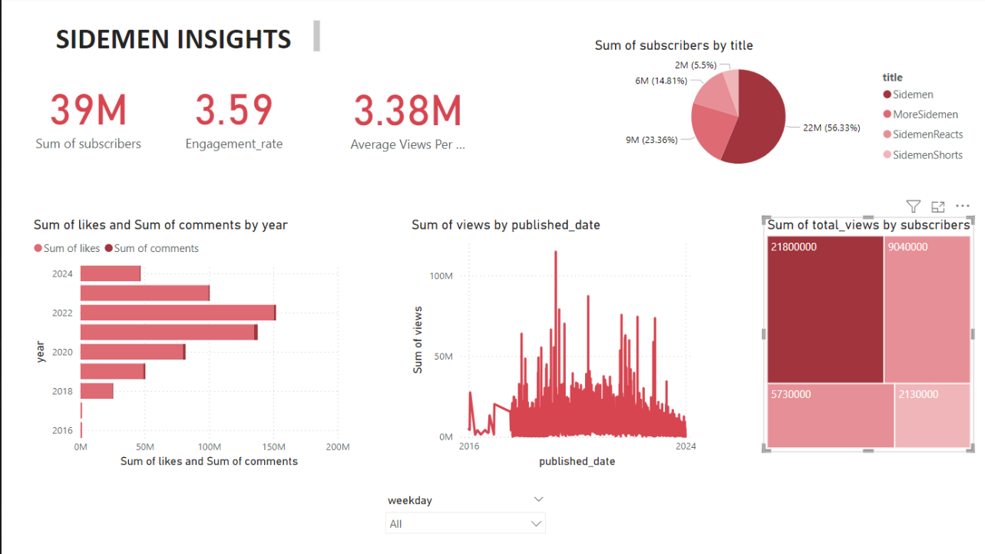

Slide 12
Pipeline video
YouTube-Data-Pipeline

Slide 13
fin.

